Slide 1
Module 14
Understanding security, and some best practices

Slide 2
Objectives
How attacks happen
Understanding major attack surfaces
Front-end
Javascript execution
Network level
Man-in-the-middle
API/development level
Open APIs
Database level
SQL injection
System level
Incorrect logs, Server vulnerabilities that allow remote code execution

Slide 3
Common loopholes that cause security breaches
Edge cases missed out by the developer OR breaking a developer’s (incorrect) assumptions
Developer forgets to add an authentication/authorization check to an API endpoint
http://thenextweb.com/insider/2015/03/23/how-i-hacked-indias-biggest-startup/
Being able to execute code where it should not be allowed
Upload a file (PHP) instead of uploading an image
Going to that path where the image is stored: http://site.com/images/file.php will execute the source code of the file instead of serving the image unless the directory or apache are configured to not allow execution of any files inside the images directory
Being able to access unauthorized data
Production access was not supposed to be given to tester.
So tester credentials were not stored very secretly
Hacker got access to tester credentials, was able to access production database
Denial of service
An attack that aims to make a network or server software component unavailable to its users
Make so many requests to a site, that normal users can’t reach the site
Social engineering, or even being stupid
We might have very secure systems. But if we are not careful about where keys/passwords/credentials are stored, then there is no point.

Slide 4
Architecture of a webapp
Web server
Network
Browser
(web client)
response
Computer (host)
request
Vulnerability in:
1. webapp source code
2. The browser
1. Reading traffic between client and server to capture data
2. DOS attacks on network components
3. Man-in-the-middle attacks
Vulnerabilities in webapp source code
Vulnerabilities in OS, or libraries being used

Slide 5
Webapp front-end code
Users (and hackers) have full access to your front-end code
That means that you can’t store any secret data, or credentials to your code
You are dependent on the browser to provide security to your webapp
Eg: Chrome browser extensions can ask the user for permissions to read/modify data on the webapp
That means that if there is a malicious extension, it can extract your session-id from your webapps cookies and send them somewhere else
Include safe javascript libraries from safe locations
If you include a 3rd party javascript file in your webapp source code, you are giving that javascript file full access to do anything on the webapp
A <script> tag in the HTML will be executed by the browser: (XSS attacks)
Validate user-input while sending or while displaying
If you are showing comments written by your user, make sure that the HTML is templated successfully.
For eg: What if I type a comment: <script>alert(‘Hello’);</script> as a comment on a flipkar product? Every time someone loads the product page, and my comment is loaded, the alert box will load. Now image if I’m a bad person.
Follow best practices:
Update libraries you use frequently
Ask your users to stay on the latest browsers

Slide 6
Network security
The network is not owned by you (the developer).
So anything can happen: Man-in-the-middle-attack
End-to-end encryption is the only way to secure data as it is in transit from the browser to the server
HTTPS is secured HTTP with end to end encryption by using SSL certificates installed on the server
(SSH is also end to end encrypted)
This means that if anyone gets hold of the data as it is enroute from the client to the server, the data will be gibberish
However, even the endpoint is not guaranteed to be safe (MITM attack)
If you are connecting to a server (say google.com) how do you know if that server is actually google.com?
Verified SSL certificates are installed on the server
For every HTTPS connection, the browser checks the cross-verifies the SSL certificate signature given to it with a Certificate Authority that the browser trusts
What CAs does a browser trust? It’s a part of the browser itself! You can add your own trusted CAs if you want to
Summary: Always use HTTPS wherever possible!

Slide 7

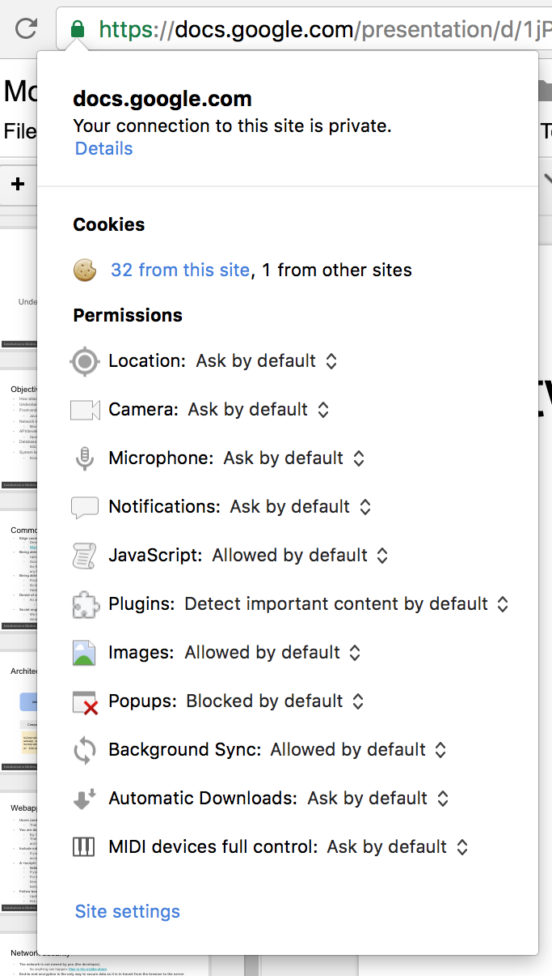
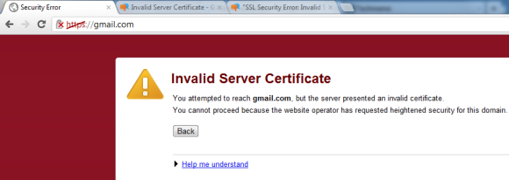
Network security

Slide 8
API/Webapp development
Make sure every API/page request has:
Authentication: Check if the user is actually who the user claims to be (token ⇔ user-id)
Authorization: Check if the user has access to the particular API/page
Sanitize all input that users send:
If you’re expecting user’s to send data of a particular type, verify that it is actually that type
Try to write as little code as possible, while leveraging mature libraries written by the (open-source) community
Do not implement your own hashing algorithm
Do not store any credentials, tokens or configuration data in your source code
Exchange these credentials with your developers only if required, and that too over secure channels
Eg: Lastpass
Configuration data/credentials (like database username/password) should only be present in a file on the server machine. It can be put there manually; not automatically copied there while copying the code
Update server-side software, OS, and source code dependencies regularly

Slide 9
API/Webapp development
Make sure every API/page request has:
Authentication: Check if the user is actually who the user claims to be (token ⇔ user-id)
Authorization: Check if the user has access to the particular API/page
Sanitize all input that users send:
If you’re expecting user’s to send data of a particular type, verify that it is actually that type
Try to write as little code as possible, while leveraging mature libraries written by the (open-source) community
Do not implement your own hashing algorithm
Do not store any credentials, tokens or configuration data in your source code
Exchange these credentials with your developers only if required, and that too over secure channels
Eg: Lastpass
Configuration data/credentials (like database username/password) should only be present in a file on the server machine. It can be put there manually; not automatically copied there while copying the code
Update server-side software, OS, and source code dependencies regularly

Slide 10
Best development/deployment practices
Access the database safely
Don’t log secure information
Don’t print out sensitive information as log output from your server-side code
Eg: In your login API endpoint, don’t print out the username/password as logs
Why? Because if anyone gets access to the logs, then it’s like getting access to the database
Separate staging (testing) & production environment
Don’t execute any file/source-code that is not guaranteed to be from the development team
Use secure methods like SSH (not FTP) to manage your servers
Preferably set up key based access and not just password access
Separate admin users from read/write users from read users
Don’t execute raw SQL statements on the database if any part of that SQL statement depends on user-input
SQL injection attacks
Use mature libraries and frameworks to connect to a database that automatically escape the SQL for you.

Slide 11
Key takeaways
Each point in this module!
Try to understand why each point is the way it is by getting into more detail

